Slide 1





On Efficient Solvers for Fixed-Point Equations: Classical Results and New Twists
$$T\left(x\right)=x?$$
Lipschitz constant $γ$ of $T$
$$0$$
$$1$$
Jelena Diakonikolas (UW-Madison)
Workshop on Regret, Optimization, and Games, November 2025

Slide 2
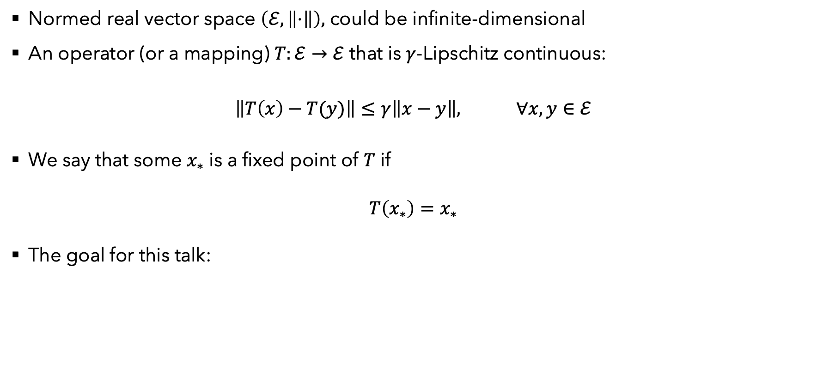
Setup for this talk
Normed real vector space $\left(ℰ, \left\|⋅\right\|\right),$ could be infinite-dimensional
An operator (or a mapping) $T:ℰ→ℰ$ that is $γ$-Lipschitz continuous:
$$\left\|T\left(x\right)−T(y)\right\|≤γ\left\|x−y\right\|, ∀x, y∈ℰ$$
We say that some $x_{∗}$ is a fixed point of $T$ if
$$T\left(x_{∗}\right)=x_{∗}$$
The goal for this talk:
Given $ε>0$, find $\hat{x}∈ℰ$ such that $\left\|T\left(\hat{x}\right)−\hat{x}\right\|≤ε$

Slide 3
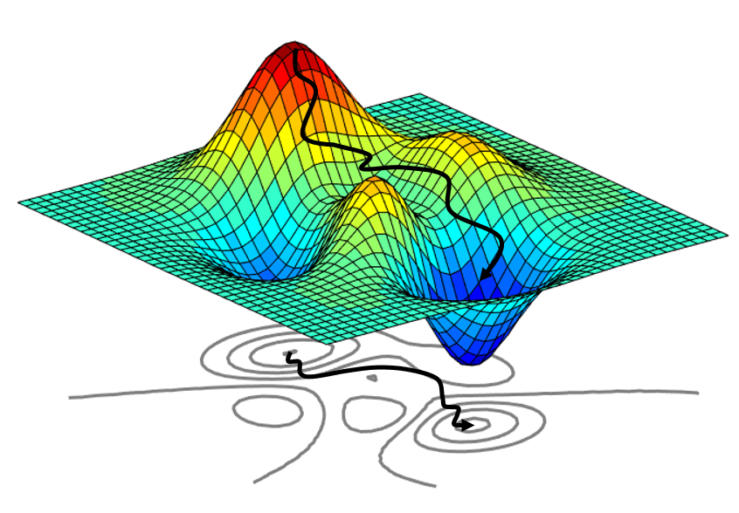
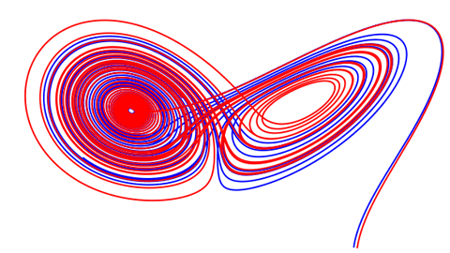

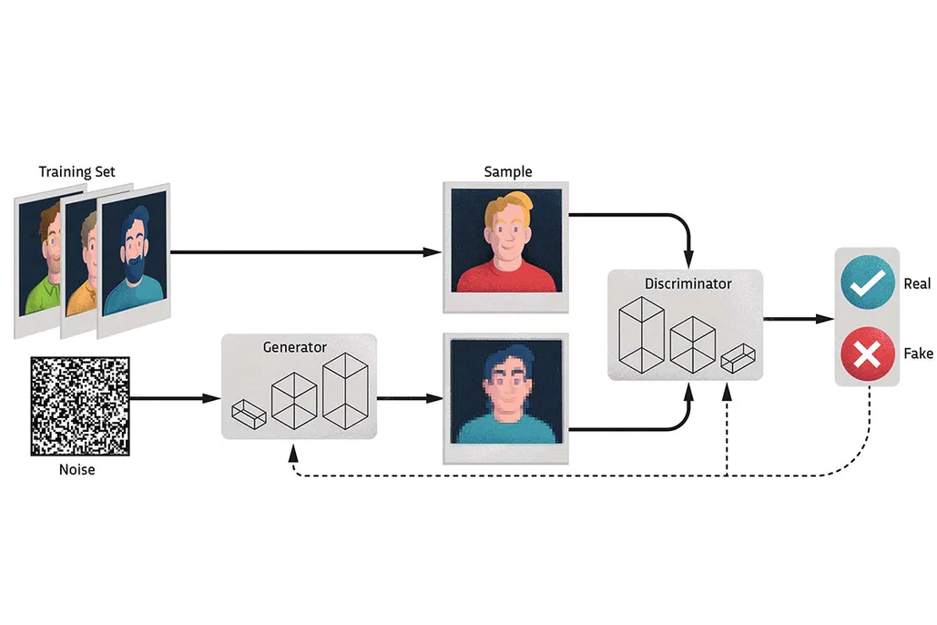
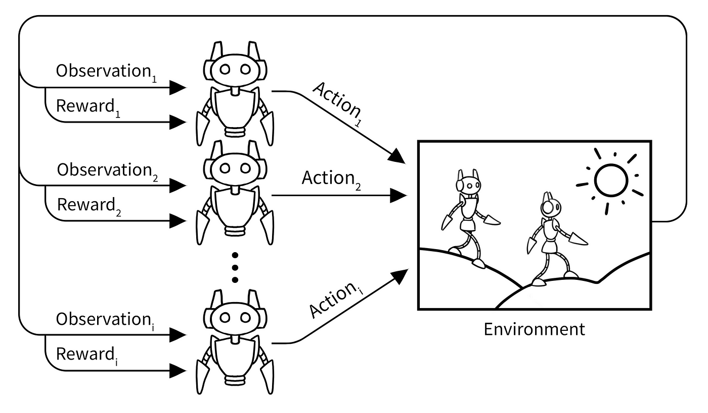

Why solve fixed-point equations?
$$T\left(x_{∗}\right)=x_{∗}$$

Slide 4
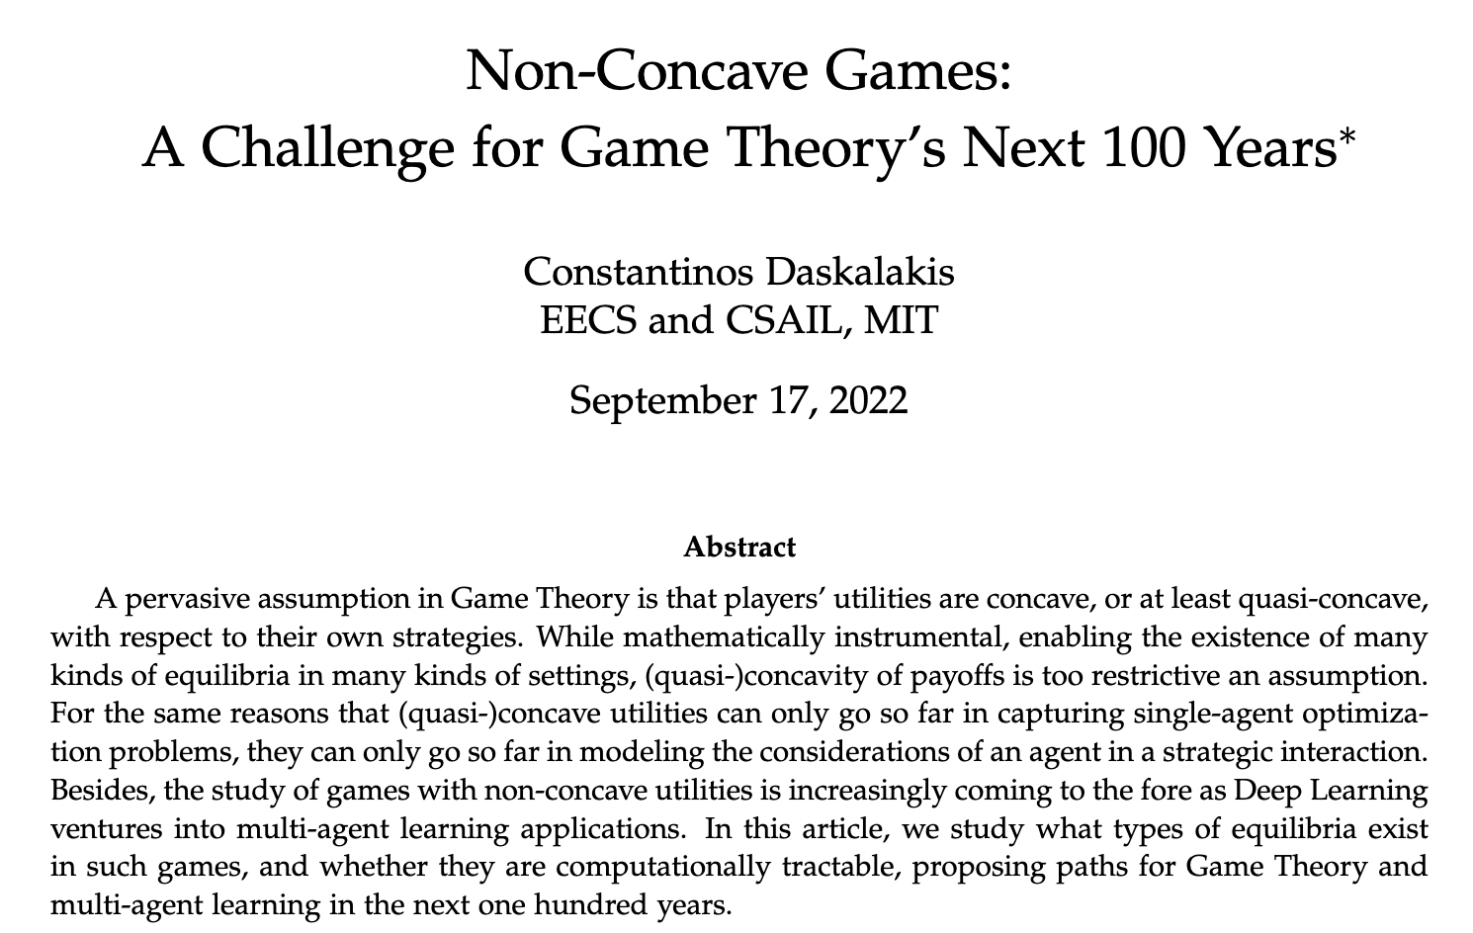

Slide 5
What we know about this problem:
Existence of fixed points (a very small sample of known results)

Slide 6




Existence of a fixed point
Finite-dimensional space $\left(ℰ, \left\|⋅\right\|\right)$:
Lipschitz constant $γ$ of $T$
$$0$$
$$1$$
Guaranteed to exist, by classical Banach fixed point theorem [Banach, 1922]
Guaranteed to exist whenever $T$ is a self-map of a compact convex set, by classical Brouwer fixed point theorem [Brouwer, 1911]

Slide 7
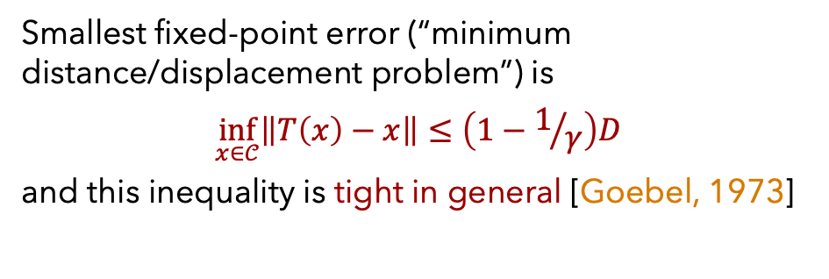
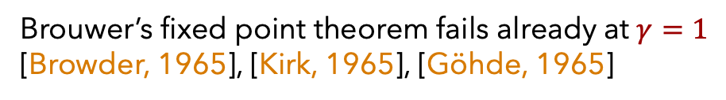
Existence of a fixed point
Infinite-dimensional Banach space $\left(ℰ, \left\|⋅\right\|\right)$:
Assumption: $T:𝒞→𝒞,$ where $𝒞$ is convex, compact, of diameter $D<∞$
Lipschitz constant $γ$ of $T$
$$0$$
$$1$$
Smallest fixed-point error (“minimum distance/displacement problem”) is
$$\inf_{x∈𝒞}\left\|T\left(x\right)−x\right\|≤\left(1−1/γ\right)D$$
and this inequality is tight in general [Goebel, 1973]
Guaranteed to exist, by classical Banach fixed point theorem [Banach, 1922]
Brouwer’s fixed point theorem fails already at $γ=1$ [Browder, 1965], [Kirk, 1965], [Göhde, 1965]
For the rest of the talk, whenever we consider $γ>1$, we make the above Assumption

Slide 8
What we know about this problem:
Complexity of finding elements with small fixed-point error

Slide 9


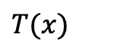
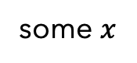
Complexity definitions
Oracle (or information-based) complexity [Nemirovski-Yudin, 1983], [Traub-Wozniakovski, 1980]:
Given oracle access to an operator $T$ belonging to a certain class (e.g., all $γ$-Lipschitz operators with $γ<1$) and a target error $ε>0,$ what is the smallest number of queries to $T$ that any algorithm must take on its worst-case instance in the class to output $x$ with $\left\|T\left(x\right)−x\right\|≤ε$ ?
some $x$
$T(x)$
Nearly all algorithms for solving fixed-point equations are oracle-based
Worth a mention: the challenges associated with approximating (Brouwer) fixed-point equations (finite dimension, convex compact set) inspired reduction-based complexity classes in TCS like PPAD [Papadimitriou, 1994] and FIXP [Etessami, Yannakakis, 2010]

Slide 10
Complexity in finite dimensions
Lipschitz constant $γ$ of $T$
$$0$$
$$1$$
$γ<1:$
Upper bounds:
$\left\lceil \frac{\ln\left({\left\|T\left(x_{0}\right)−x_{0}\right\|}/ε\right)}{ln⁡(1/γ)}\right\rceil$ (folklore), using Picard (a.k.a.) Banach iteration $x_{k+1}=T(x_{k})$, applies to any norm
$O\left(d\log\left(1/ε\right)\right)$ [Huang, Khachiyan, Sikorski, 1999] for $ℓ_{2}$ norm, $T$ a self-map of unit $ℓ_{2}$ ball or $O\left(d^{2}\log\left(1/ε\right)\right)$ [Chen, Li, Yannakakis, 2024] for $ℓ_{∞}$ norm, $T$ a self-map of unit hypercube
Lower bounds (all for $ℓ_{2}$ norm):
“high dimension:” $Ω\left(\frac{\ln\left({\left\|T\left(x_{0}\right)−x_{0}\right\|}/ε\right)}{\ln\left(1/γ\right)}\right)$ [Chou, 1987], [Nemirovski, 1991], [Park-Ryu, 2022]
“low dimension:” $Ω(d\log{(1/ε)})$ [Khachiyan, 1999]

Slide 11

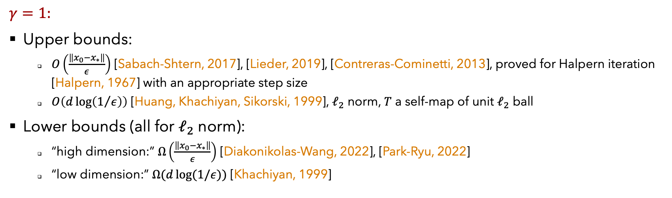


Complexity in finite dimensions
Lipschitz constant $γ$ of $T$
$$0$$
$$1$$
$γ=1:$
Upper bounds:
$O\left(\frac{\left\|x_{0}−x_{∗}\right\|}{ε}\right)$ [Sabach-Shtern, 2017], [Lieder, 2019], [Contreras-Cominetti, 2013], proved for Halpern iteration [Halpern, 1967] with an appropriate step size
$O\left(d\log\left(1/ε\right)\right)$ [Huang, Khachiyan, Sikorski, 1999], $ℓ_{2}$ norm, $T$ a self-map of unit $ℓ_{2}$ ball
Lower bounds (all for $ℓ_{2}$ norm):
“high dimension:” $Ω\left(\frac{\left\|x_{0}−x_{∗}\right\|}{ε}\right)$ [Diakonikolas-Wang, 2022], [Park-Ryu, 2022]
“low dimension:” $Ω(d\log{(1/ε)})$ [Khachiyan, 1999]

Slide 12
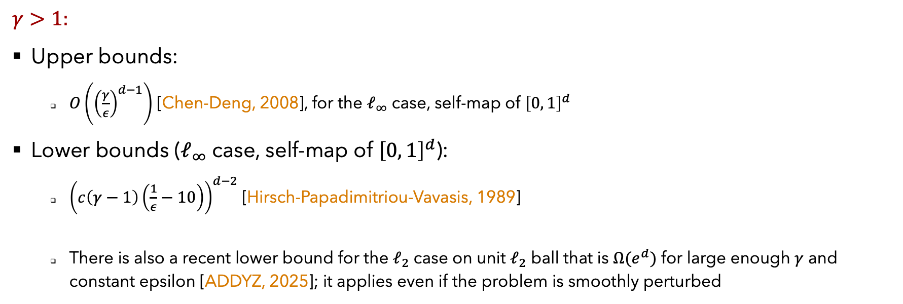
Complexity in finite dimensions
Lipschitz constant $γ$ of $T$
$$0$$
$$1$$
$γ>1:$
Upper bounds:
$O\left({\left(\frac{γ}{ε}\right)}^{d−1}\right)$ [Chen-Deng, 2008], for the $ℓ_{∞}$ case, self-map of ${\left[0, 1\right]}^{d}$
Lower bounds ($ℓ_{∞}$ case, self-map of ${\left[0, 1\right]}^{d}$):
${\left(c\left(γ−1\right)\left(\frac{1}{ε}−10\right)\right)}^{d−2}$ [Hirsch-Papadimitriou-Vavasis, 1989]
There is also a recent lower bound for the $ℓ_{2}$ case on unit $ℓ_{2}$ ball that is $Ω(e^{d})$ for large enough $γ$ and constant epsilon [ADDYZ, 2025]; it applies even if the problem is smoothly perturbed
note the implications for the infinite-dimensional case!!!

Slide 13

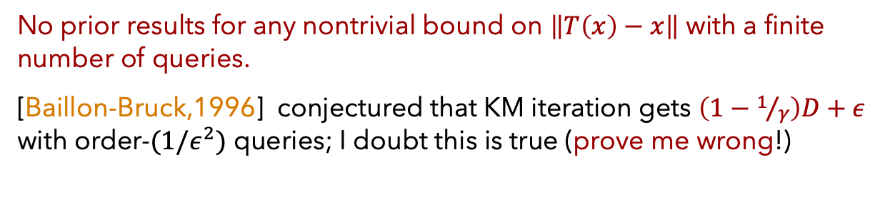

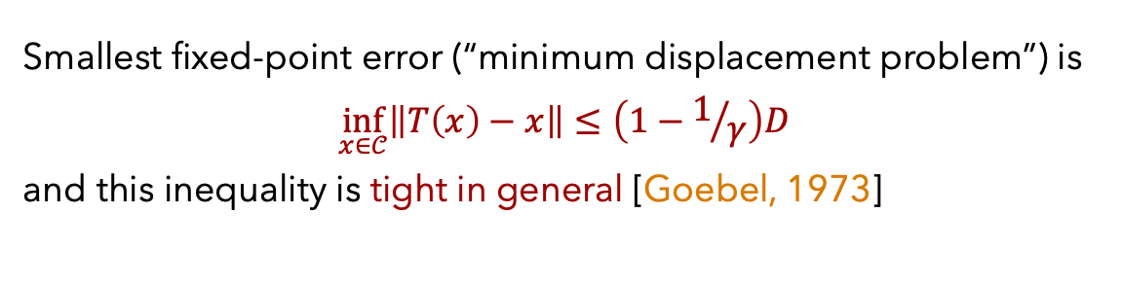

Complexity in infinite dimension
Lipschitz constant $γ$ of $T$
$$0$$
$$1$$
Assumption: $T:𝒞→𝒞,$ where $𝒞$ is convex, compact, of diameter $D<∞$
The same upper bounds for Picard and Halpern iteration still apply here
Smallest fixed-point error (“minimum displacement problem”) is
$$\inf_{x∈𝒞}\left\|T\left(x\right)−x\right\|≤\left(1−1/γ\right)D$$
and this inequality is tight in general [Goebel, 1973]
No prior results for any nontrivial bound on $\left\|T\left(x\right)−x\right\|$ with a finite number of queries.
[Baillon-Bruck,1996] conjectured that KM iteration gets $\left(1−1/γ\right)D+ε$ with order-$(1/ε^{2})$ queries; I doubt this is true (prove me wrong!)

Slide 14

Bottom Line & Main Question
We know a lot about efficiently solving fixed point equations when $γ≤1$.
When $γ=1+Ω(ε/D)$, the problem is notoriously hard in general.
What lies in between?

Slide 15
New results and twists:
Convergence of Fixed-Step Halpern Iteration (FixHal)

Slide 16
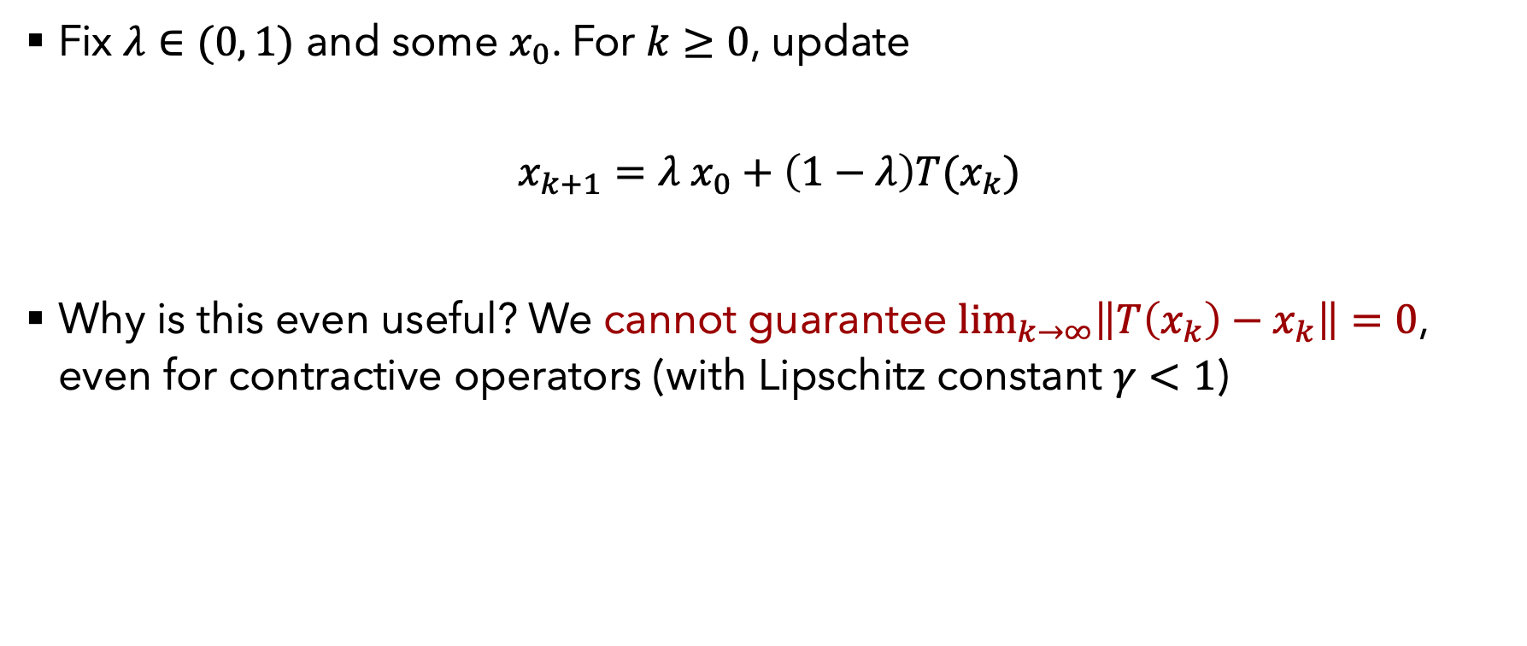
Fixed-step Halpern Iteration (FixHal)
Fix $λ∈(0, 1)$ and some $x_{0}$. For $k≥0$, update
$$x_{k+1}=λ x_{0}+\left(1−λ\right)T(x_{k})$$
Why is this even useful? We cannot guarantee $\lim_{k→∞}\left\|T\left(x_{k}\right)−x_{k}\right\|=0$, even for contractive operators (with Lipschitz constant $γ<1$)

Slide 17
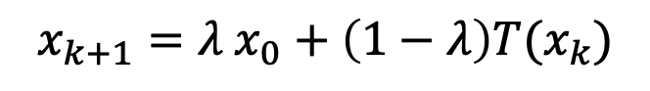
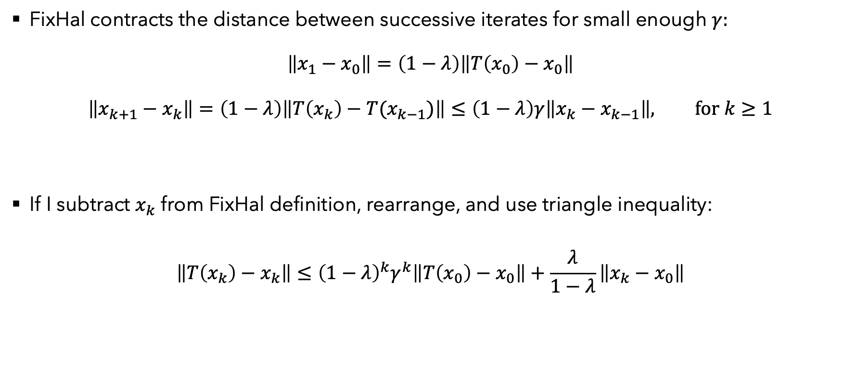
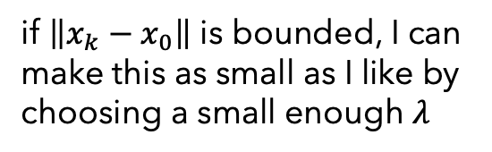

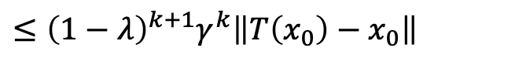
Some simple observations
$$x_{k+1}=λ x_{0}+\left(1−λ\right)T(x_{k})$$
FixHal contracts the distance between successive iterates for small enough $γ:$
$$\left\|x_{1}−x_{0}\right\|=\left(1−λ\right)\left\|T\left(x_{0}\right)−x_{0}\right\|$$
$$\left\|x_{k+1}−x_{k}\right\|=\left(1−λ\right)\left\|T\left(x_{k}\right)−T(x_{k−1})\right\|≤\left(1−λ\right)γ\left\|x_{k}−x_{k−1}\right\|, for k≥1$$
If I subtract $x_{k}$ from FixHal definition, rearrange, and use triangle inequality:
$$\left\|T\left(x_{k}\right)−x_{k}\right\|≤{\left(1−λ\right)}^{k}γ^{k}\left\|T\left(x_{0}\right)−x_{0}\right\|+\frac{λ}{1−λ}\left\|x_{k}−x_{0}\right\|$$
$$≤{\left(1−λ\right)}^{k+1}γ^{k}\left\|T\left(x_{0}\right)−x_{0}\right\|$$
if $\left\|x_{k}−x_{0}\right\|$ is bounded, I can make this as small as I like by
choosing a small enough $λ$
diminishes geometrically if
$γ<1/(1−λ)$

Slide 18
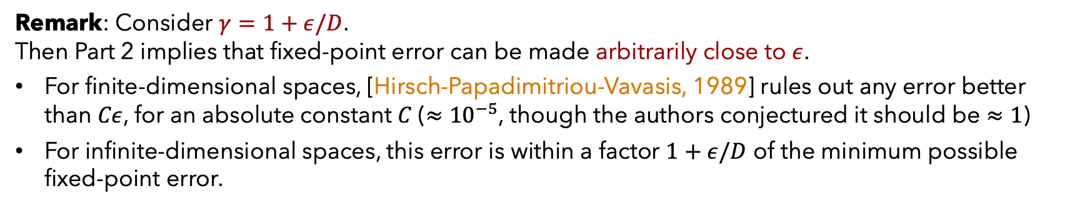
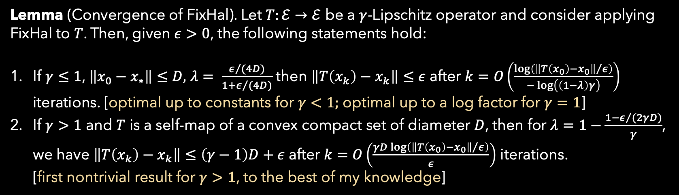
Convergence of FixHal
Lemma (Convergence of FixHal). Let $T:ℰ→ℰ$ be a $γ$-Lipschitz operator and consider applying FixHal to $T$. Then, given $ε>0$, the following statements hold:
If $γ≤1$, $\left\|x_{0}−x_{∗}\right\|≤D,$ $λ= \frac{ε/{(4D)}}{1+ε/{(4D)}}$ then $\left\|T\left(x_{k}\right)−x_{k}\right\|≤ε$ after $k=O\left(\frac{\log\left({\left\|T\left(x_{0}\right)−x_{0}\right\|}/ε\right)}{−\log\left(\left(1−λ\right)γ\right)}\right)$ iterations. [optimal up to constants for $γ<1;$ optimal up to a log factor for $γ=1$]
If $γ>1$ and $T$ is a self-map of a convex compact set of diameter $D$, then for $λ=1−\frac{1−ε/{(2γD)}}{γ}$, we have $\left\|T\left(x_{k}\right)−x_{k}\right\|≤\left(γ−1\right)D+ε$ after $k=O\left(\frac{γD\log\left({\left\|T\left(x_{0}\right)−x_{0}\right\|}/ε\right)}{ε}\right)$ iterations. [first nontrivial result for $γ>1$, to the best of my knowledge]
Remark: Consider $γ=1+ε/D$.
Then Part 2 implies that fixed-point error can be made arbitrarily close to $ε$.
For finite-dimensional spaces, [Hirsch-Papadimitriou-Vavasis, 1989] rules out any error better than $Cε$, for an absolute constant $C$ ($≈{10}^{−5}$, though the authors conjectured it should be $≈1$)
For infinite-dimensional spaces, this error is within a factor $1+ε/D$ of the minimum possible fixed-point error.

Slide 19
New results and twists:
Gradual Halpern Algorithm (GHAL) and its Convergence

Slide 20
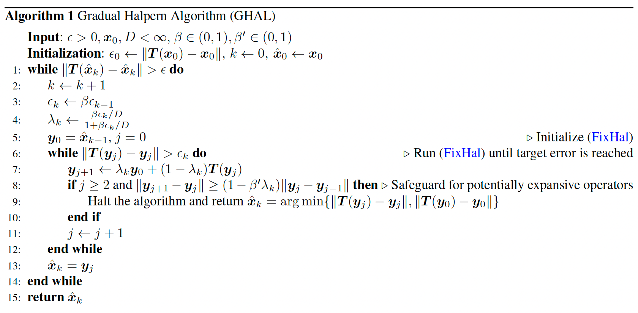

Gradual Halpern Algorithm (GHAL)
Idea: gradually reduce the step size $λ$ to adapt to the unknown Lipschitz constant $γ$
Here: assume that the diameter $D$ of a set containing algorithm iterates is known (this can be relaxed, but seems of limited value if we allow $γ>1$)

Slide 21
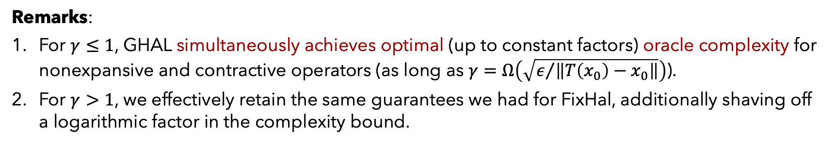

Convergence of GHAL
Proposition (Convergence of GHAL). Let $T:ℰ→ℰ$ be a $γ$-Lipschitz operator and consider applying FixHal to $T$. Then, given $ε>0$, the following statements hold:
If $γ≤1$, then $\left\|T\left(x_{k}\right)−x_{k}\right\|≤ε$ after a total number of iterations/oracle queries to $T$ equal
$k=O\left(\min\left\{\frac{\ln\left({\left\|T\left(x_{0}\right)−x_{0}\right\|}/ε\right)\left(1+\ln\left(1/γ\right)\right)}{\ln\left(1/γ\right)}, \ln\left(\frac{1}{γ}\right)+\frac{\ln\left(γ{\left\|T\left(x_{0}\right)−x_{0}\right\|}/ε\right)}{\ln\left(1/γ\right)}, \frac{ D}{ε}\right\}\right)$
If $γ∈(1, 1+{\left\|T\left(x_{0}\right)−x_{0}\right\|}/D)$ and $T$ is a self-map of a convex compact set of diameter $D$, then
$\left\|T\left(x_{k}\right)−x_{k}\right\|≤\max{\{c\left(γ−1\right)D,}ε\}$ after $k=O\left(\min\left\{\frac{D}{ε},\frac{1}{γ−1}\right\}\right)$ iterations,
where c is a constant determined by the algorithm parameters and can be made arbitrarily close to 1 (at the cost of increasing the number of iterations by a factor $\tilde{O}(1/(c−1))$).
Remarks:
For $γ≤1$, GHAL simultaneously achieves optimal (up to constant factors) oracle complexity for nonexpansive and contractive operators (as long as $γ=Ω\left(\sqrt{ε/{\left\|T\left(x_{0}\right)−x_{0}\right\|}}\right)$).
For $γ>1$, we effectively retain the same guarantees we had for FixHal, additionally shaving off a logarithmic factor in the complexity bound.

Slide 22
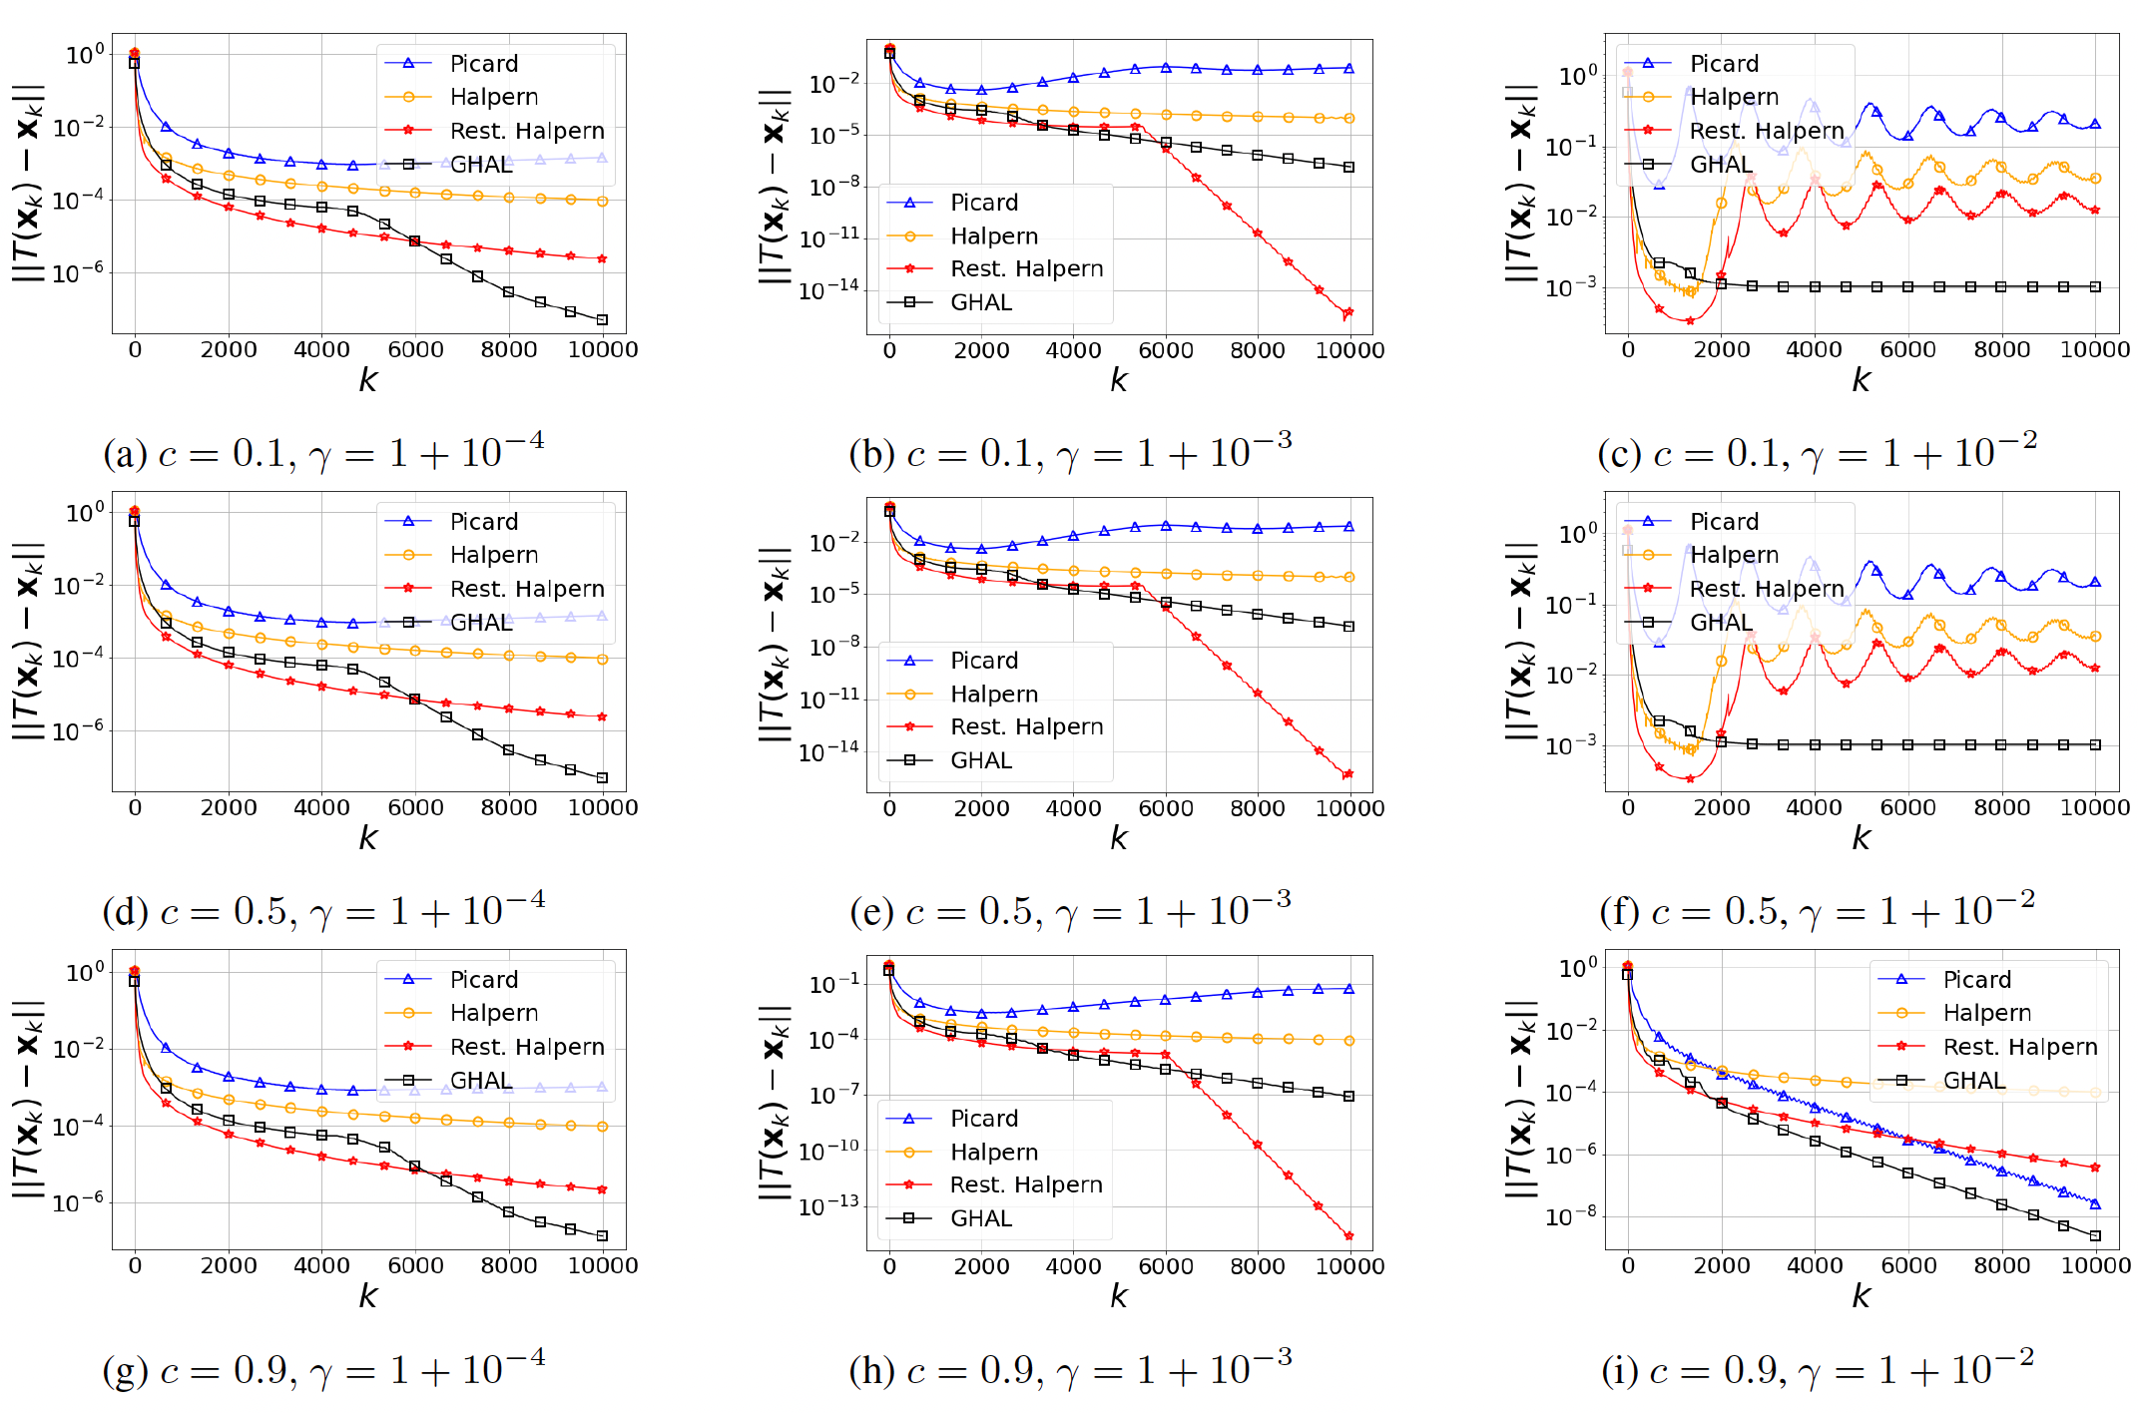
Quick numerical illustration for expansive operators

Slide 23
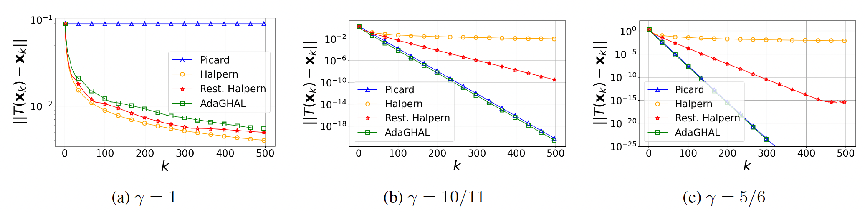
Adaptive Gradual Halpern Algorithm (AdaGHAL)
Removes the need for knowing $D$ when $γ≤1$ and retains the same convergence guarantees as GHAL
Below, numerical examples on the hard instance from [Park, Ryu, 2022], used in proving lower bounds

Slide 24
New results and twists:
Gradual Expansion and Convergence of GHAL

Slide 25


Gradually expansive operators
Definition. Let $T:𝒞→𝒞$, where $𝒞$ is compact, convex, and of diameter $D$. Let $α∈\left[0, 1\right).$
We say that $T$ is $α$-gradually expansive if for all $x, y$ in $𝒞$ it holds:
$$\left\|T\left(x\right)−T(y)\right\|≤\left(1+ \frac{α\max\left\{\left\|T\left(x\right)−x\right\|, \left\|T\left(y\right)−y\right\|\right\}}{D}\right)\left\|x−y\right\|.$$
Gradual expansion allows the operator to have expansion ($\left\|T\left(x\right)−T(y)\right\|/\left\|x−y\right\|$) up to $1+α$, even if one of the two points is a fixed point, due to the max in its definition!
Example 1. Operator $T=Π_{{\left[−D/2, D/2\right]}^{d}}\left(x+\exp\left(\left(α/D\right)x\right)\right)$ is $α$-gradually expansive w.r.t. the $ℓ_{∞}$ norm.
Example 2. Prox operator of a convex function in CAT($κ$) is locally gradually expansive, around minima.

Slide 26

Convergence of GHAL for gradually expansive operators
Definition. Let $T:𝒞→𝒞$, where $𝒞$ is compact, convex, and of diameter $D$. Let $α∈\left[0, 1\right).$
We say that $T$ is $α$-gradually expansive if for all $x, y$ in $𝒞$ it holds:
$$\left\|T\left(x\right)−T(y)\right\|≤\left(1+ \frac{α\max\left\{\left\|T\left(x\right)−x\right\|, \left\|T\left(y\right)−y\right\|\right\}}{D}\right)\left\|x−y\right\|.$$
Theorem. For any $α∈\left[0, \sqrt{2}−1\right)$ and any $ε>0,$ there is a choice of parameters in GHAL such that GHAL runs in finite time and outputs $x_{k}$ that satisfies:
$$\left\|T\left(x_{k}\right)−x_{k}\right\|≤ε.$$
In particular, if $α≤0.4$, then GHAL with parameters $β=0.975, β^{′}=1/1.01$ output such $x_{k}$ within
$$k=O\left(\frac{D}{ε}\right)$$
iterations, each requiring a constant number of calls to $T$.
Observe that this theorem implies that for $α∈\left[0, \sqrt{2}−1\right)$, it must be $\inf_{x∈𝒞}\left\|T\left(x\right)−x\right\|=0.$

Slide 27




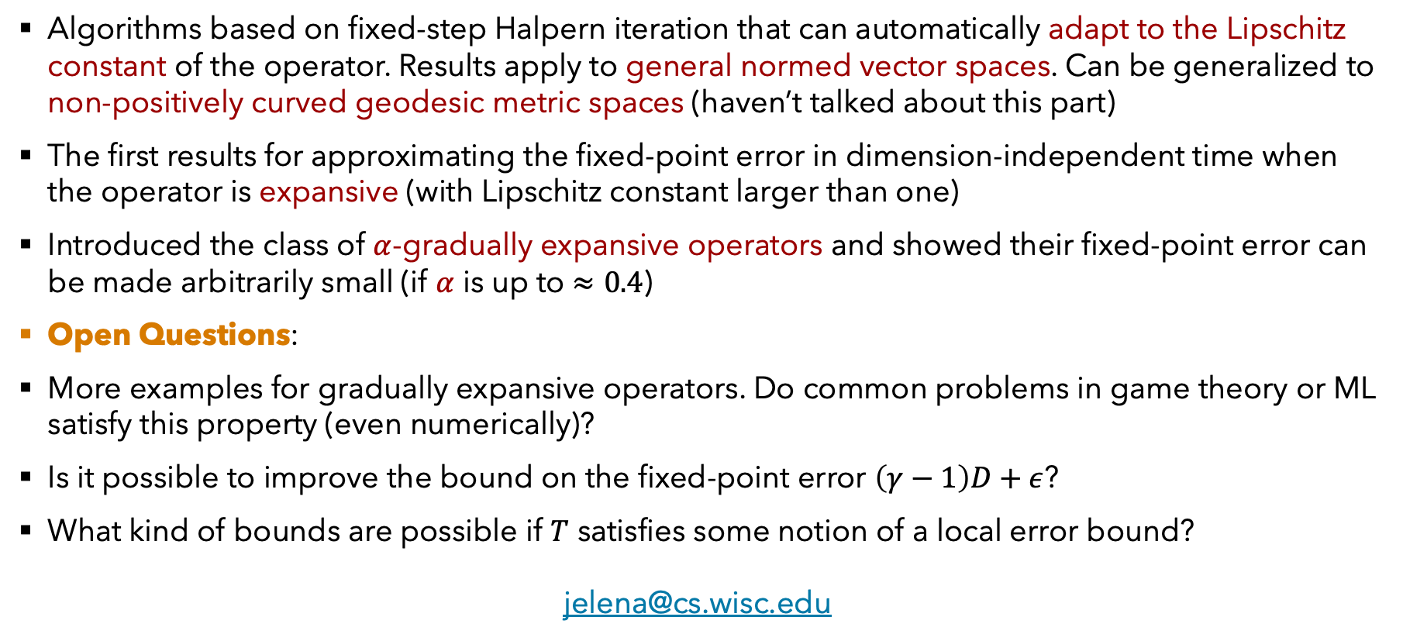
Summary and open questions
Algorithms based on fixed-step Halpern iteration that can automatically adapt to the Lipschitz constant of the operator. Results apply to general normed vector spaces. Can be generalized to non-positively curved geodesic metric spaces (haven’t talked about this part)
The first results for approximating the fixed-point error in dimension-independent time when the operator is expansive (with Lipschitz constant larger than one)
Introduced the class of $α$-gradually expansive operators and showed their fixed-point error can be made arbitrarily small (if $α$ is up to $≈0.4$)
Open Questions:
More examples for gradually expansive operators. Do common problems in game theory or ML satisfy this property (even numerically)?
Is it possible to improve the bound on the fixed-point error $\left(γ−1\right)D+ε$?
What kind of bounds are possible if $T$ satisfies some notion of a local error bound?
jelena@cs.wisc.edu
J. Diakonikolas, “Pushing the Complexity Boundaries of Fixed-Point Equations: Adaptation to Contraction and Controlled Expansion,” arXiv preprint arXiv:2506.17698, June 2025.

